Slide 1
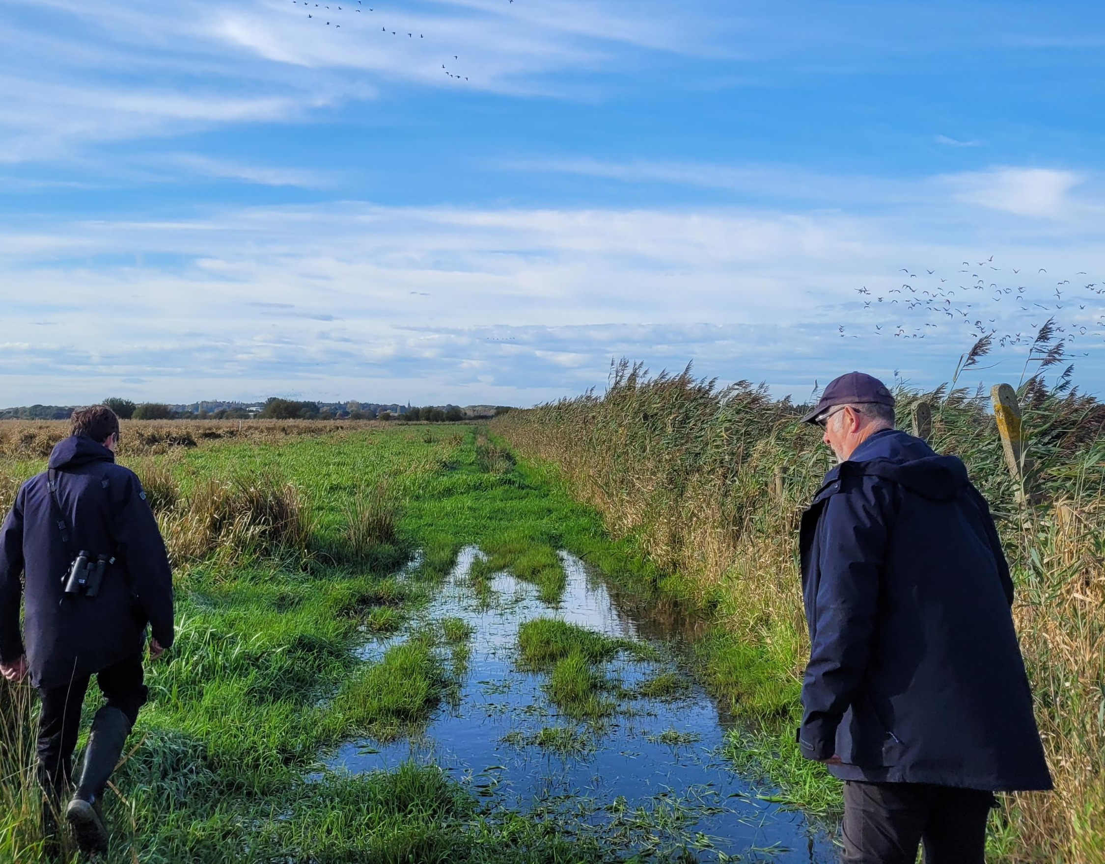

Lowland Agricultural Peat Pilot: Alt-Crossens Peat Deposits
Presented by Paul Corner and Ryan Teare

Slide 2
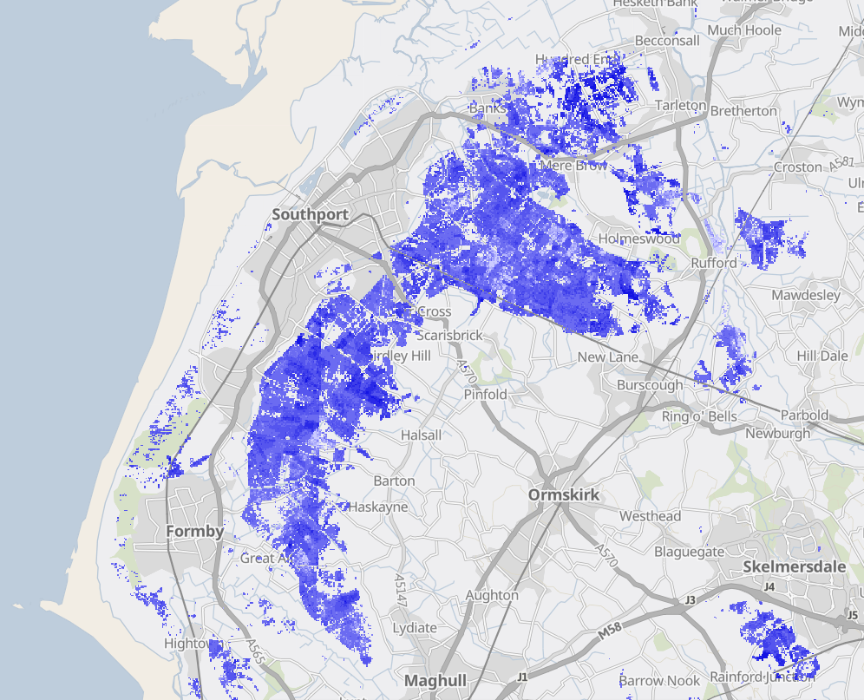



Alt-Crossens Peat Deposits
- Fields we are working in

Slide 3
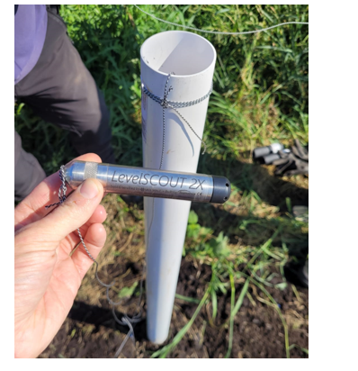
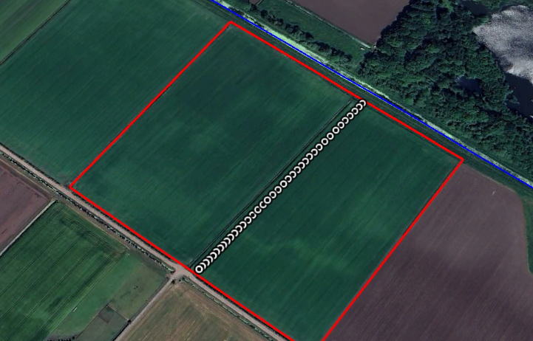
Project Overview
Aims: How can we make unproductive peat profitable again ? C Is “wetter farming” a viable option ?
Measuring Peat Depth and Quality within unproductive peat b fields.
Monitoring the response of Groundwater to rainfall events.
Using Martin Mere’s and Lunt Meadows’ peat depth and … .. ….groundwater patterns as a non-farmed comparison site.

Slide 4
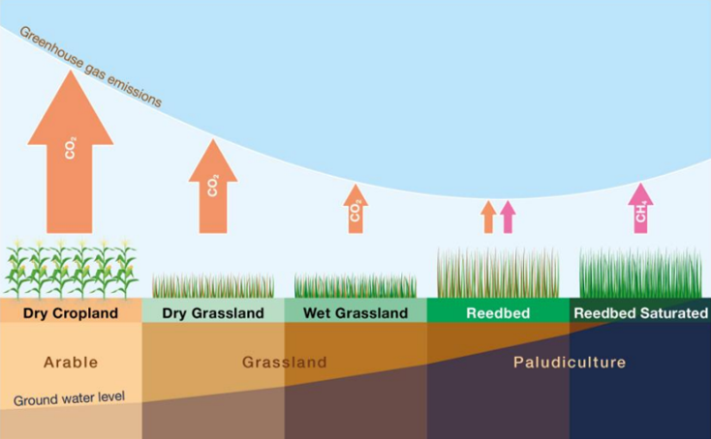
Why is there Interest ?
Peat soils store huge volumes __of greenhouse gases.
Low groundwater levels on __peat soils contribute to the __release of these gases and __therefore Climate Change.
Allowing groundwater to rise by __as little as 10cm can __significantly reduce these __emissions.

Slide 5
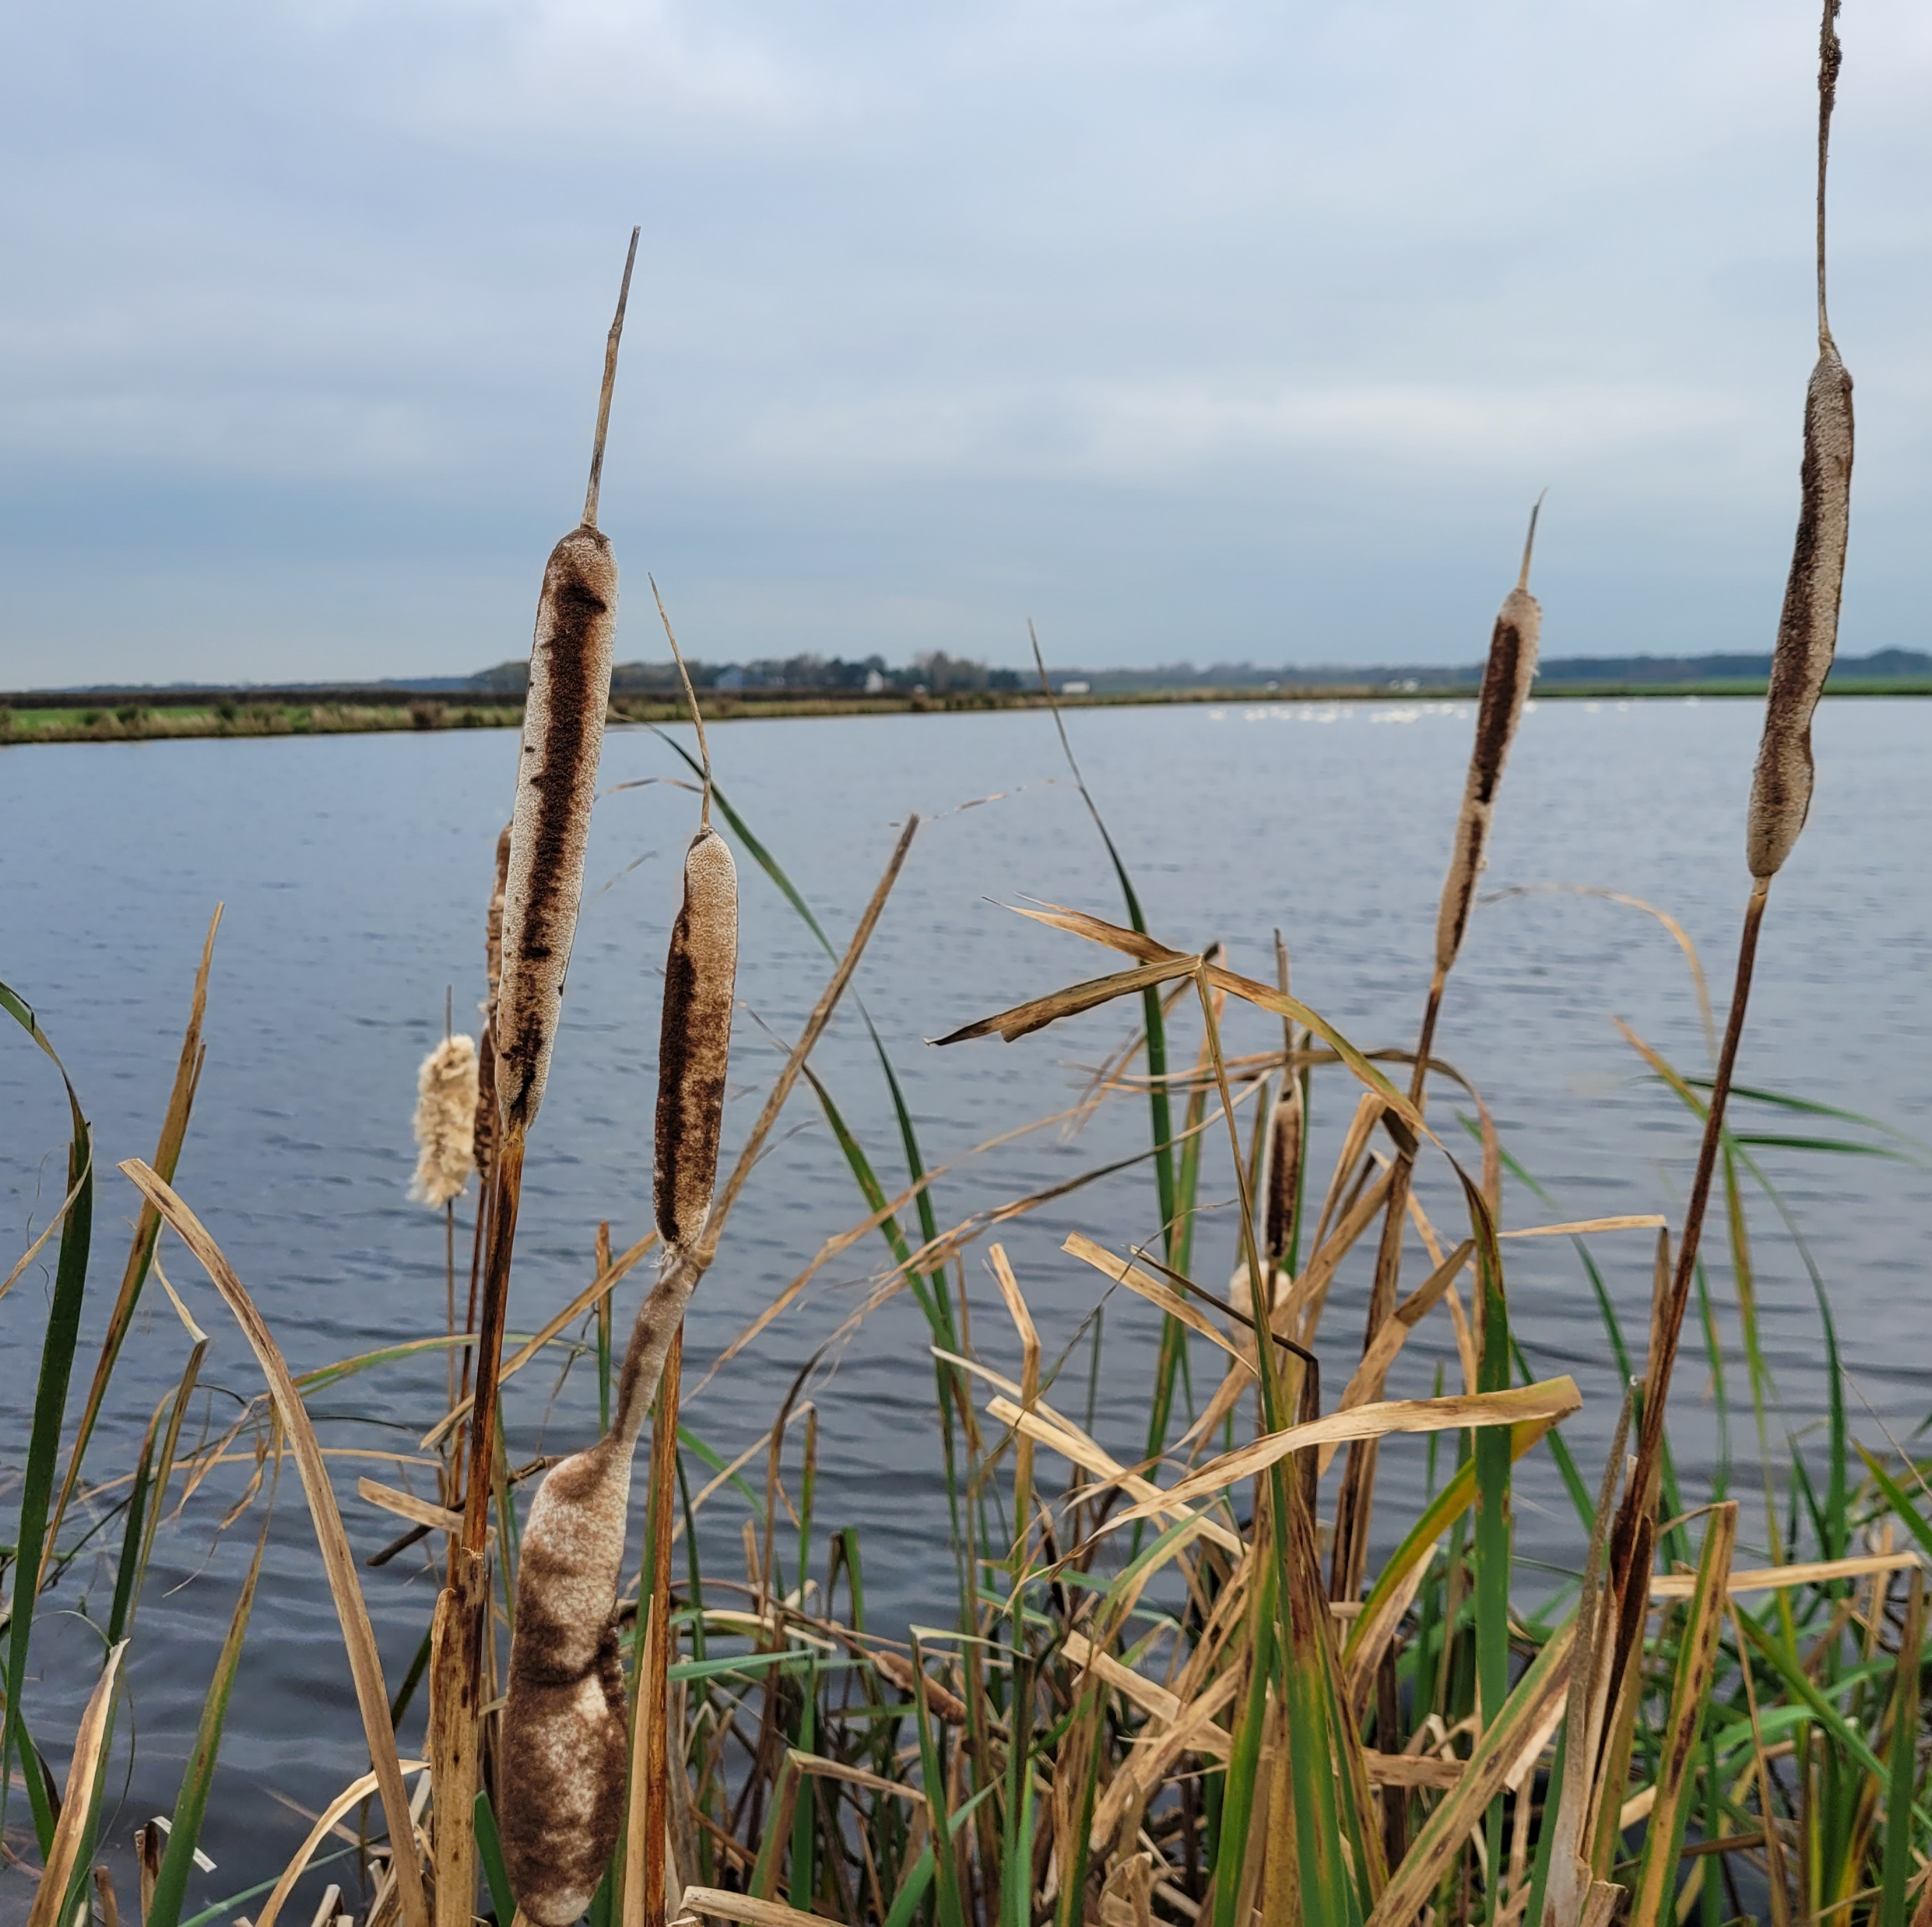
What is Paludiculture ?
Growing crops on land with a permanently raised water table .
Includes Typha and Sphagnum Moss but can include traditional crops

Slide 6
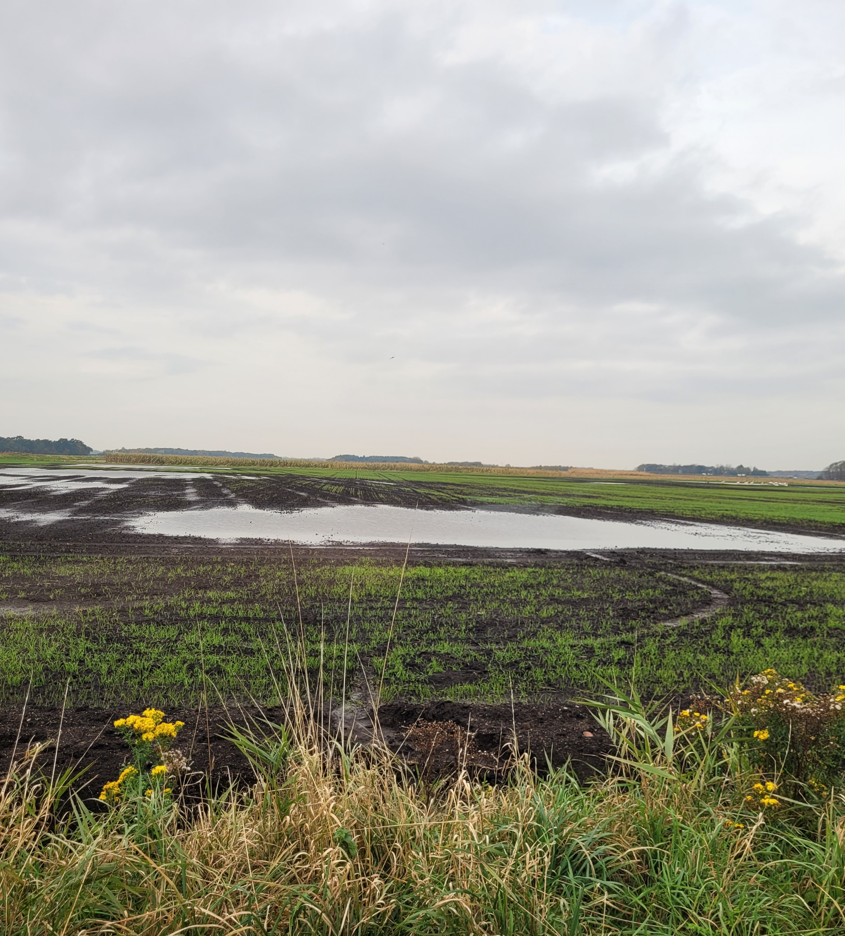
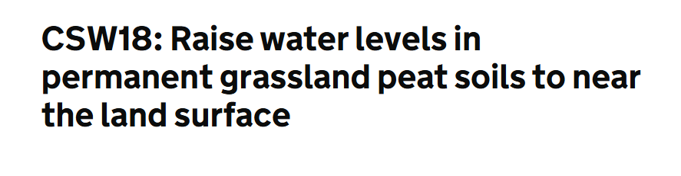
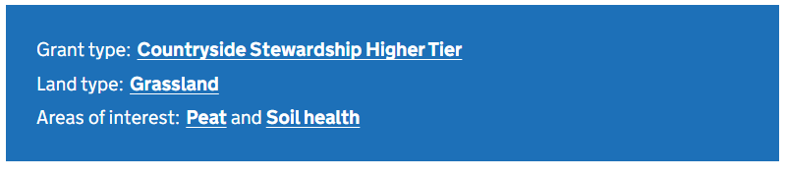

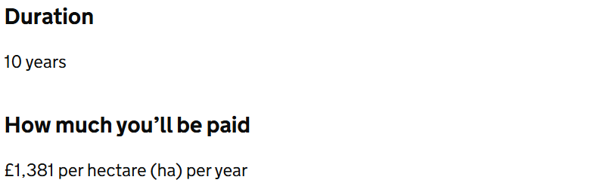
How can higher water tables benefits farmers?
Income for unproductive peaty fields.
Stewardship payments are available.
Typha can be farmed whilst receiving ….payments.
Manages nutrient run-off.
Reduces flood risk in surrounding ….fields.
Mersey Rivers Trust can install the “CSW18” monitoring required free of cost to the farmer.

Slide 7

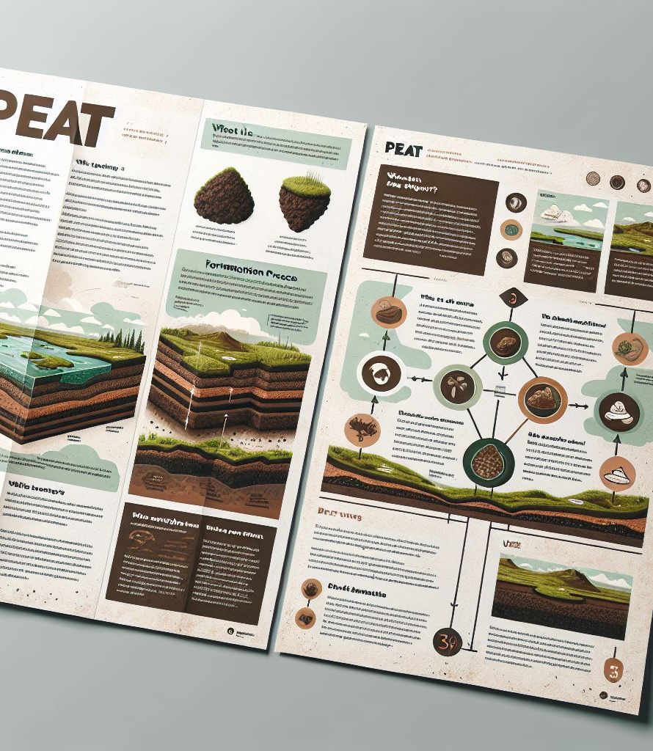
Want to get involved ?

Slide 8

Questions ?
paulc@merseyrivers.org – Project Manager
ryan@merseyrivers.org – Project Assistant

