Slide 1





Water Net Gain
Amara Coombes
Project Manager
Paul Moseley
Farm Advisor

Slide 2
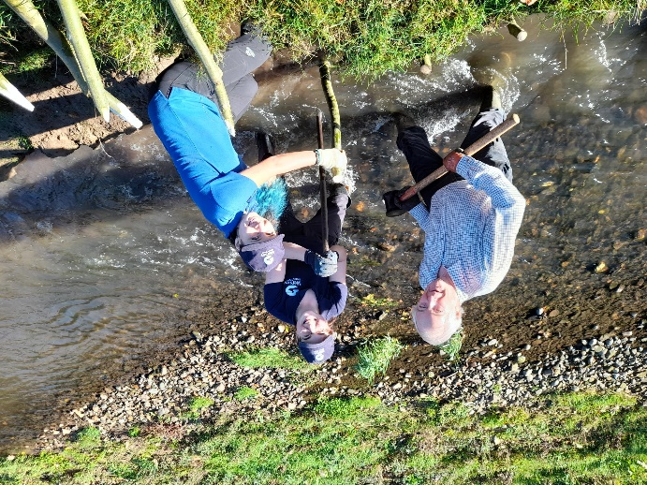
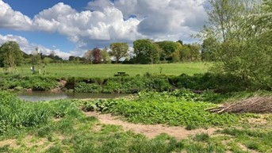
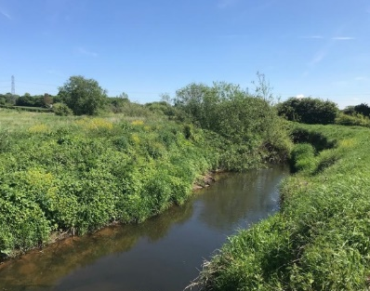
What is Water Net Gain?
Ofwat Innovation Funded as part of Water Breakthrough Challenge programme
4-year project
Currently in year 2 – one pilot in West Country and several other Rivers Trusts carrying out surveys
Notes:
Water Net Gain is funded through the Offwat Innovation fund for 4 years
The project is in its second year after a pilot year in the West Country. This year they are working through the process of creating ponds to store water and have the water released back to the environment or purchased for use by local water company.
Our project is carrying out surveys in the Downholland Catchment – more on this later

Slide 3
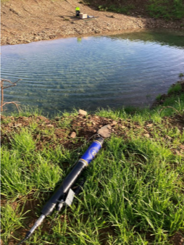
Why Water Net Gain?
Water resource deficits by 2050
Additional 1,300ML of water a day needed
Abstraction licenses will be reviewed from 2028 onwards
No new reservoirs scheduled to be built
Droughts predicted to be more common in future
Notes:
Water resource deficits predicted in much of the country by 2050 – due to further predicted droughts and increasing water use by industry
National Infrastructure Report suggests that the UK will need an additional 1,300ML of water a day in the next five years
Abstraction licenses will be reviewed in 2028 onwards, and there are predicted to be new limits on licenses as waterbodies struggle to function with pressures of abstraction and lower water levels. Licenses can be taken away or amended without compensation where there is a risk of “serious damage” to the environment. EA would lead on this.
Only two new reservoirs scheduled to be built – last one built in 1992 took over ten years to be completed and cost billions of £
Climate change is expected to cause hotter, drier summers and wetter winters, increasing the likelihood of droughts. Scientists predict that extreme soil moisture droughts could become more frequent, occurring perhaps once every five or six years in the near future.

Slide 4
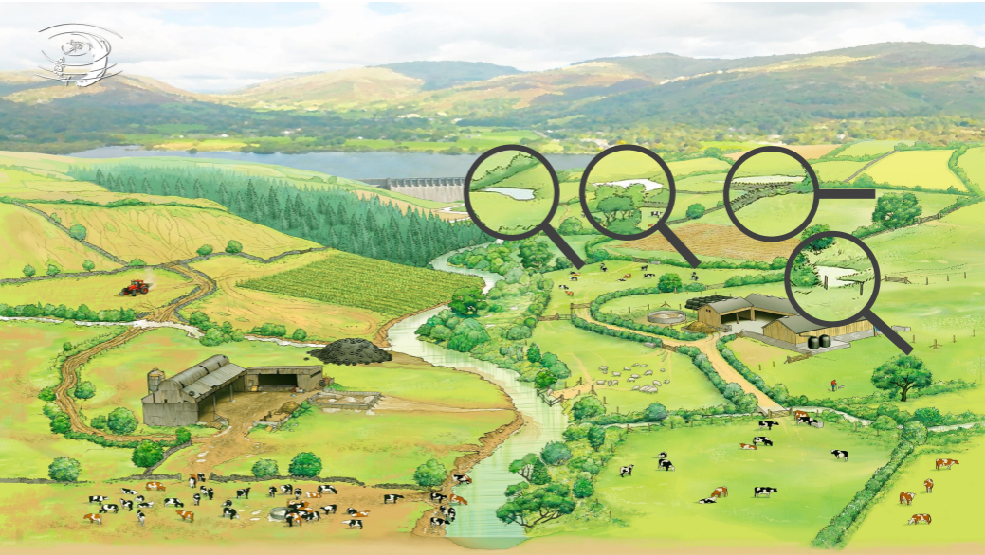
How does it work?
Notes:
Create ponds and other features to store water on the land in areas where water may have been stored years ago (old reservoirs or lagoons), or create new. This water can be used by the farm to support operations and reduce reliance on mains or abstracted water, or it can be released back to the river in order to top up water levels in dry periods.

Slide 5
How will this help?
Water Net Gain is a study to determine the feasibility of a catchment-scale approach to storing water
How could this improve:
Water use on farm
Adaptability of wider society
Improve rivers
Wildlife benefits
Lower water bills
Farmers are paid to store water on their land. Payments for pond installation, monitoring and maintenance
Notes:
WNG is a study to determine how feasible it is to create ponds on a catchment scale and have these as a network of nature based solutions that can be used to release water back to the environment or use on farm.
Farmers would be paid to store water on their land
This ponds would support resilience of the farm, wider society (other water users) and the rivers. It would improve river health and wildlife (less water stress in drought times), mean lower water bills for those on mains.
Farmers paid to store water on their land, paid to install ponds, monitoring equipment and maintenance.
Ponds where water is used on farm are around 500m3 to 3,000m3, low cost to install, can be created under permitted development (does not need planning), reduces water bills
Ponds to release water back to the river would be between 3,000m3 and 10,000m3, will require planning and is high cost but a lot of costs will be repaid throughout project

Slide 6

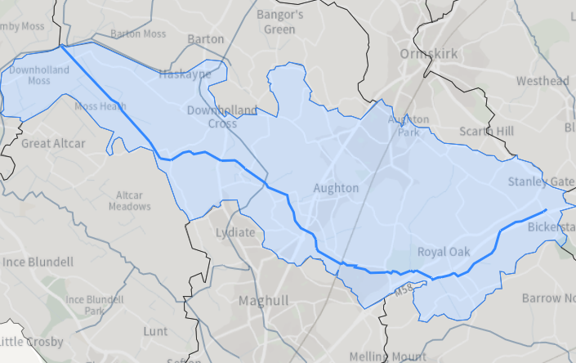
Why Downholland?
Notes:
Downholland catchment where this study is focussed is suffering from over-abstraction from farming and industry, and drought periods in summers
Sees severe surface water flooding in winter
Is one of the reasons why this waterbody is classified as in Poor Ecological Status

Slide 7
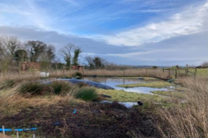
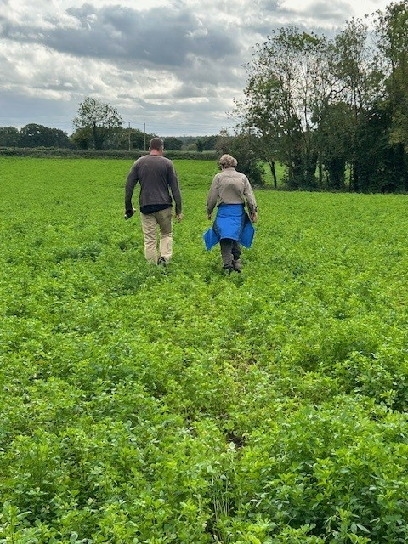
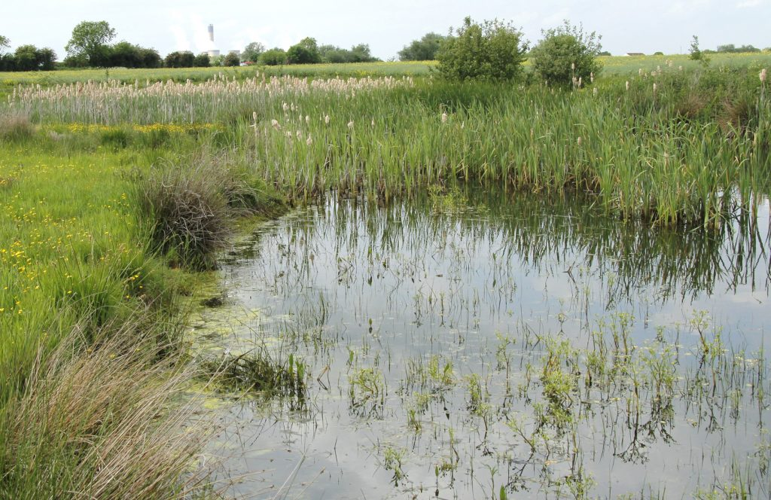
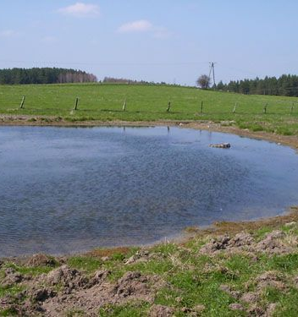
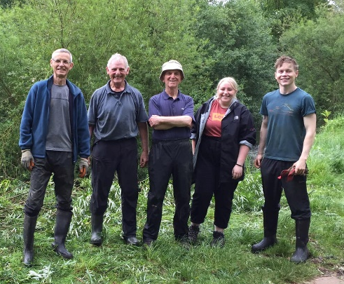
Want to know more?
Complete a survey with us
No obligation
Will run through scenarios
Takes 1 ½ - 2 hours
Can provide maps and
further advice
‘In it to win it’
Notes:
If you like to know more about the Water Net Gain project come and speak to one of us during the day today
We can arrange a visit to your farm. Here we will run through the survey and look at where there might be the possibility to put ponds on your farm
This usually takes 1 – 2 hours
We can also give further advice or pass you on to other professionals who may be able to support with other areas of farm management
There is no obligation and you can withdraw at any time but in order to be considered for funding to build a pond on your farm you must have completed a survey

Slide 8
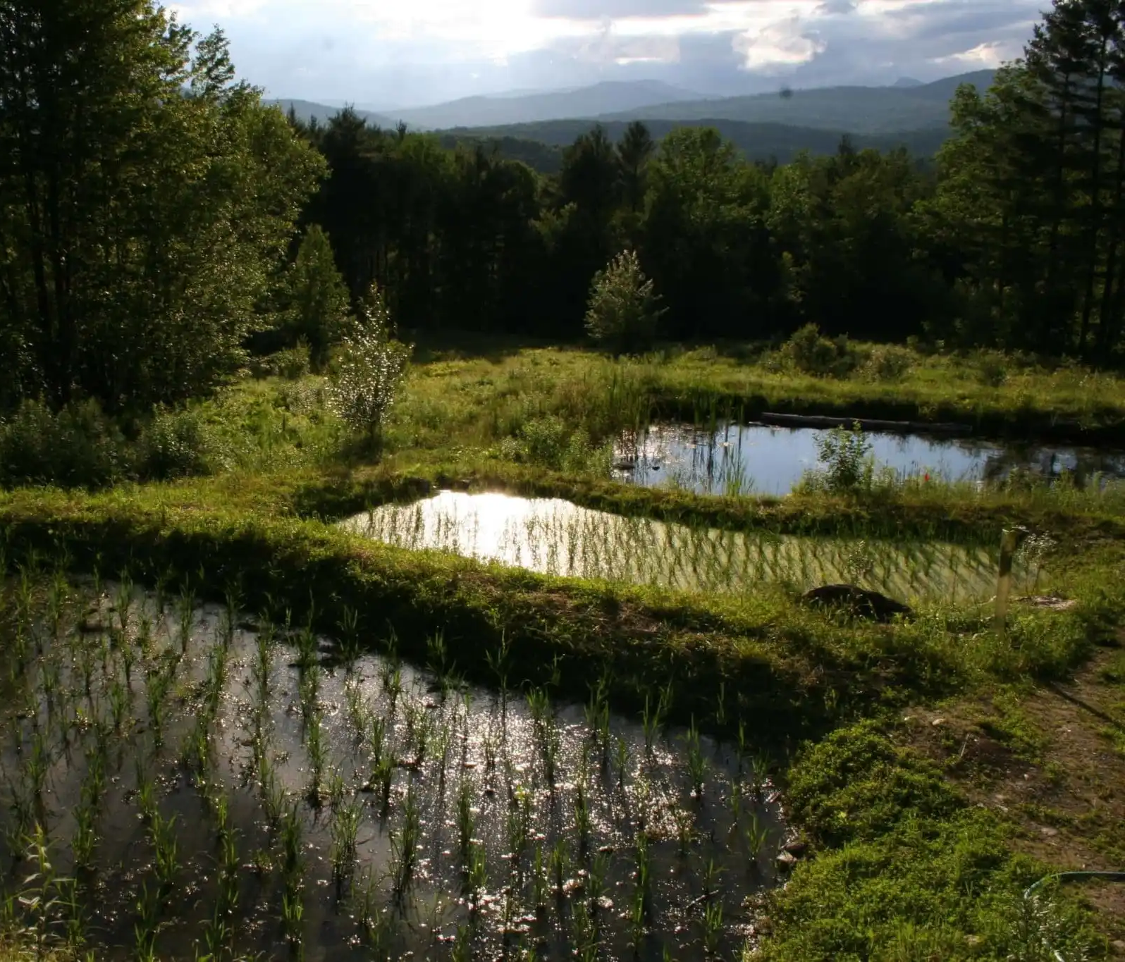
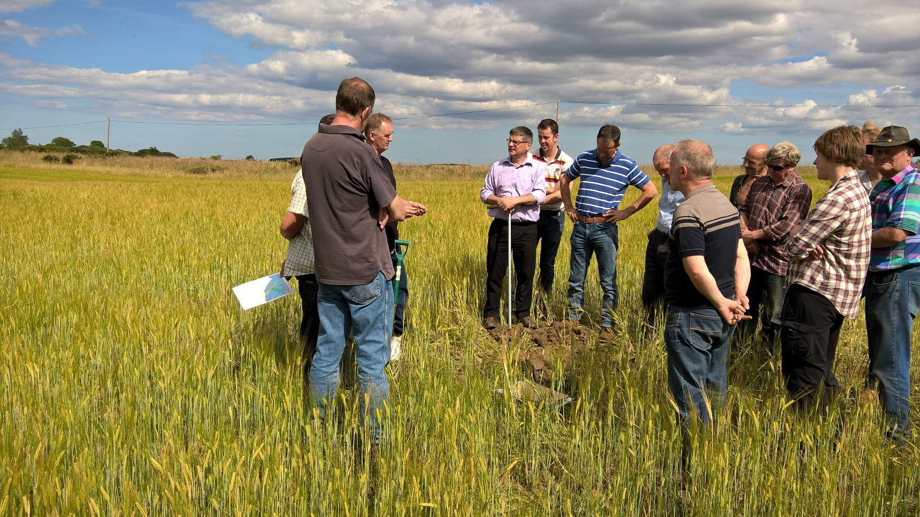
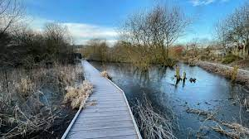
Look it up
Websites:
https://wrt.org.uk/project/water-net-gain/
https://www.merseyriverstrust.org/projects/projects-folder/water-net-gain

Slide 9





Thank You
Email: farming@merseyrivers.org

