Slide 1
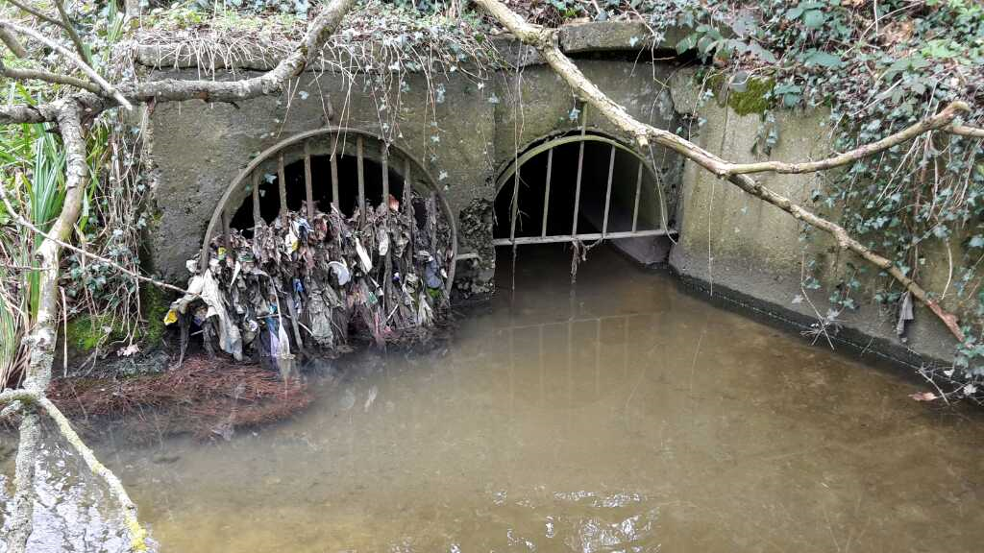


Outfall Safari Briefing and Planning
© Zoological Society of London
Upper Mersey Catchment
Abbie Goodby, Mersey Rivers Trust
January 2026

Slide 2

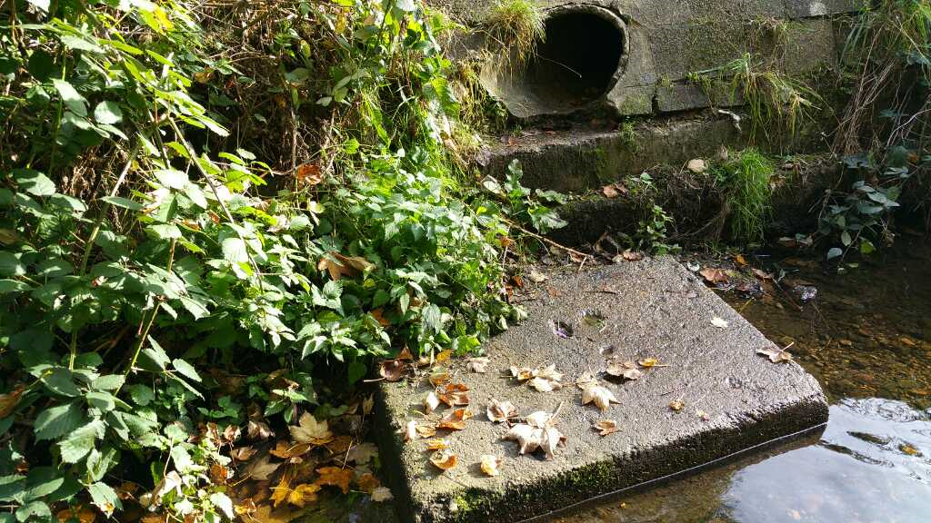

Contents
Overview of Upper Mersey Catchment
What are outfalls and why survey them?
Risk assessment
Kit list for Outfall Safari
Outfall Safari method
Reporting from the river
What will happen with the data?

Slide 3
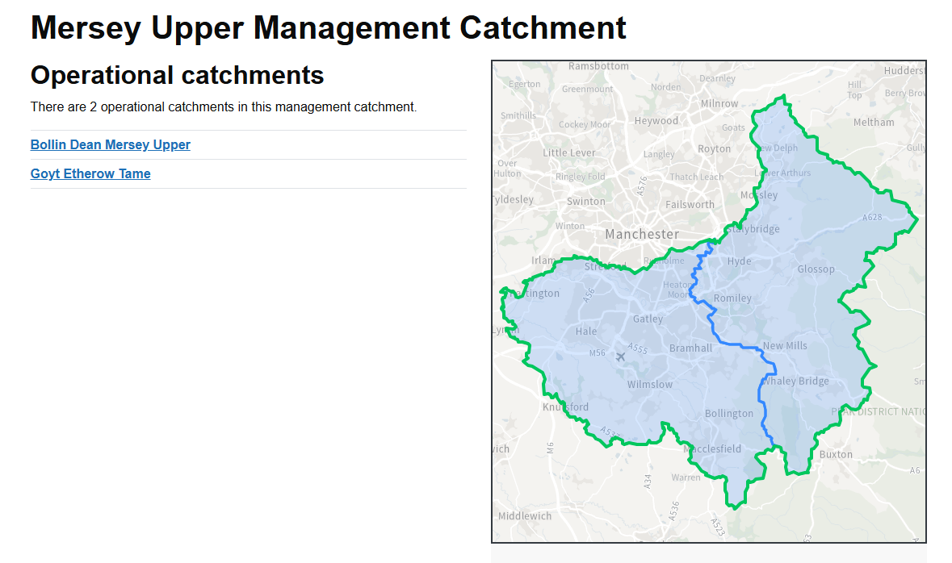


Overview of Upper Mersey Catchment.
Mersey Upper Management Catchment | Catchment Data Explorer

Slide 4
Purpose of the Outfall Safari
Systematically inspect, record and map the dry weather condition behaviour of surface water outfalls in the Upper Mersey Catchment
To report serious pollution problems from the river to the Environment Agency and to prioritise outfalls for remediation.
Environment Agency incident hotline
Telephone: 0800 80 70 60
Report an incident online:
Report an environmental problem - GOV.UK
Notes:
More information about reporting incident can be found here:
'Report an environmental problem' at your fingertips | Engage Environment Agency
Report an environmental problem - GOV.UK

Slide 5
Outfall Safari Methodology
A survey of all the outfalls will take place 3 times a year along your stretch of the local watercourse.
Your assessment answers for each outfall will be converted into an Impact Score for the outfall.
Only one form per outfall, please.
If you see any changes to an outfall between surveys, record them in epicollect.
Notes:
Method:
A survey of all the outfalls will take place 3 times a year along your stretch of the local watercourse. Your assessment answers for each outfall will be converted into an Impact Score for the outfall. Only one form per outfall, please.
If you see any changes to an outfall between surveys, record them in epicollect.
This is a record what you see not what you know survey.
Weather and coordinating survey dates:
Rain and high river levels wash away evidence of pollution, so we ideally need 48 hours of no or only light rain in the catchment before conducting any survey work. Once you have completed your survey, please let riverguardians@merseyrivers.org know if any sections were inaccessible and therefore not surveyed.

Slide 6

Impact score
Flow coming from the Outfall
Visual Impact of the Outfall
Aesthetics of the Outfall
9. Ranking of the flow coming out of the outfall
No flow | 0
Trickle: < 0.1 l/s (or enough to fill a teacup in a minute) | 1
Low flow: Between 0.1 and 1 l/s (or enough to fill a bucket in a minute) | 2
Moderate flow: 1 to 2 l/s (more than a bucket-full each minute) | 3
High flow: Clearly > 2 l/s (more than a bathtub in a minute) | 4
10. Ranking of the visual impact of the outfall
No visible effect | 0
Within 2m of the outfall | 2
Impact 2 to 10m | 4
Impact 10-30m | 6
Impact greater than 30m | 10
11. Ranking of the aesthetics of the outfall
No odour or visible aesthetics | 0
Faint smell, slight discolouration | 2
Mild smell, mild discolouration, small coverage of sewage fungus | 4
Strong smell, strong discolouration, large coverage of sewage fungus and/or litter | 6
Gross smell, gross sewage | 10

Slide 7
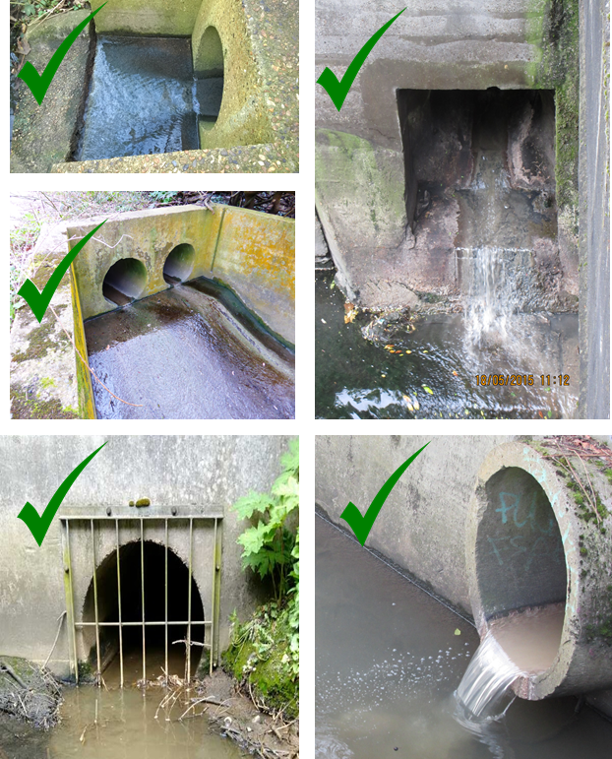
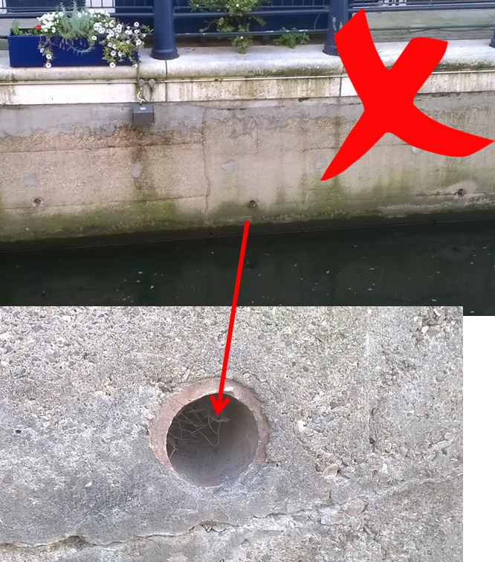


Surface water outfalls: What are they?
Discharge point of pipes that convey rainfall run-off into rivers – move water from land to the river
Generally >20cm diameter
If in doubt, or you see signs of pollution, assess it
© Zoological Society of London
Notes:
This slide is based on the national scheme developed by ZSL with Thames water which has a very different Network to what MRT has up here in the North West with UU, as such edits to the national method has been made.
MRT survey method will include all pipe diameter, as question 8 ask what range of size the pipe is.

Slide 8
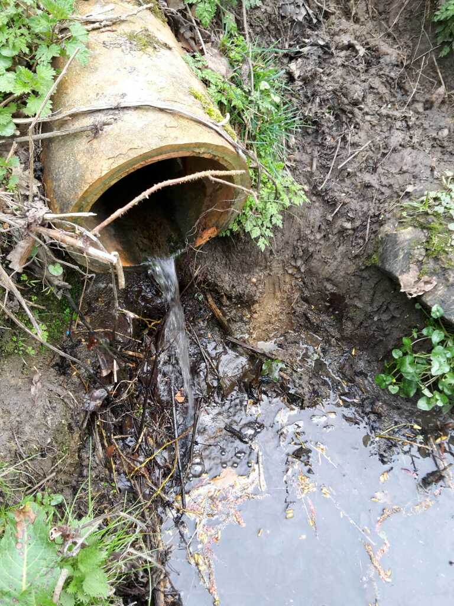
Surface water outfalls: How do they become polluted?
Appliances and washing facilities are incorrectly plumbed in or misconnected to surface water drains → waste water ends up in rivers via outfalls
Cross connected sewers i.e. between foul and surface water drains (two systems should be separate)
© Zoological Society of London
Notes:
Next slide is a diagram to show potential misconnections.

Slide 9
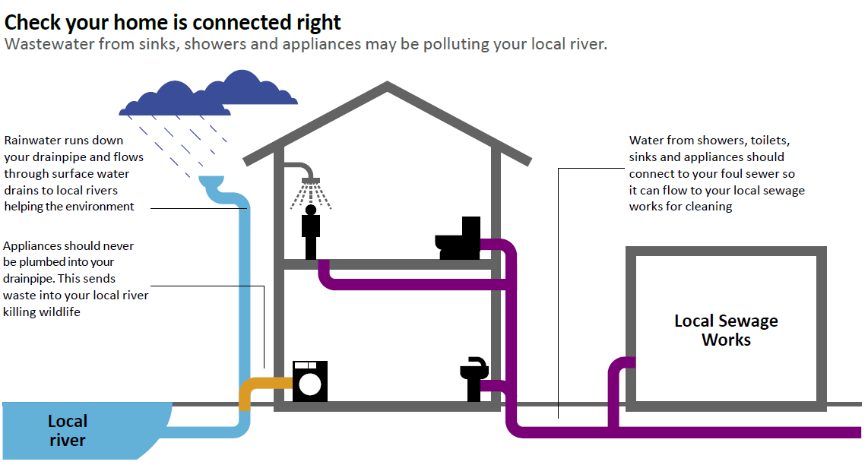

Slide 10




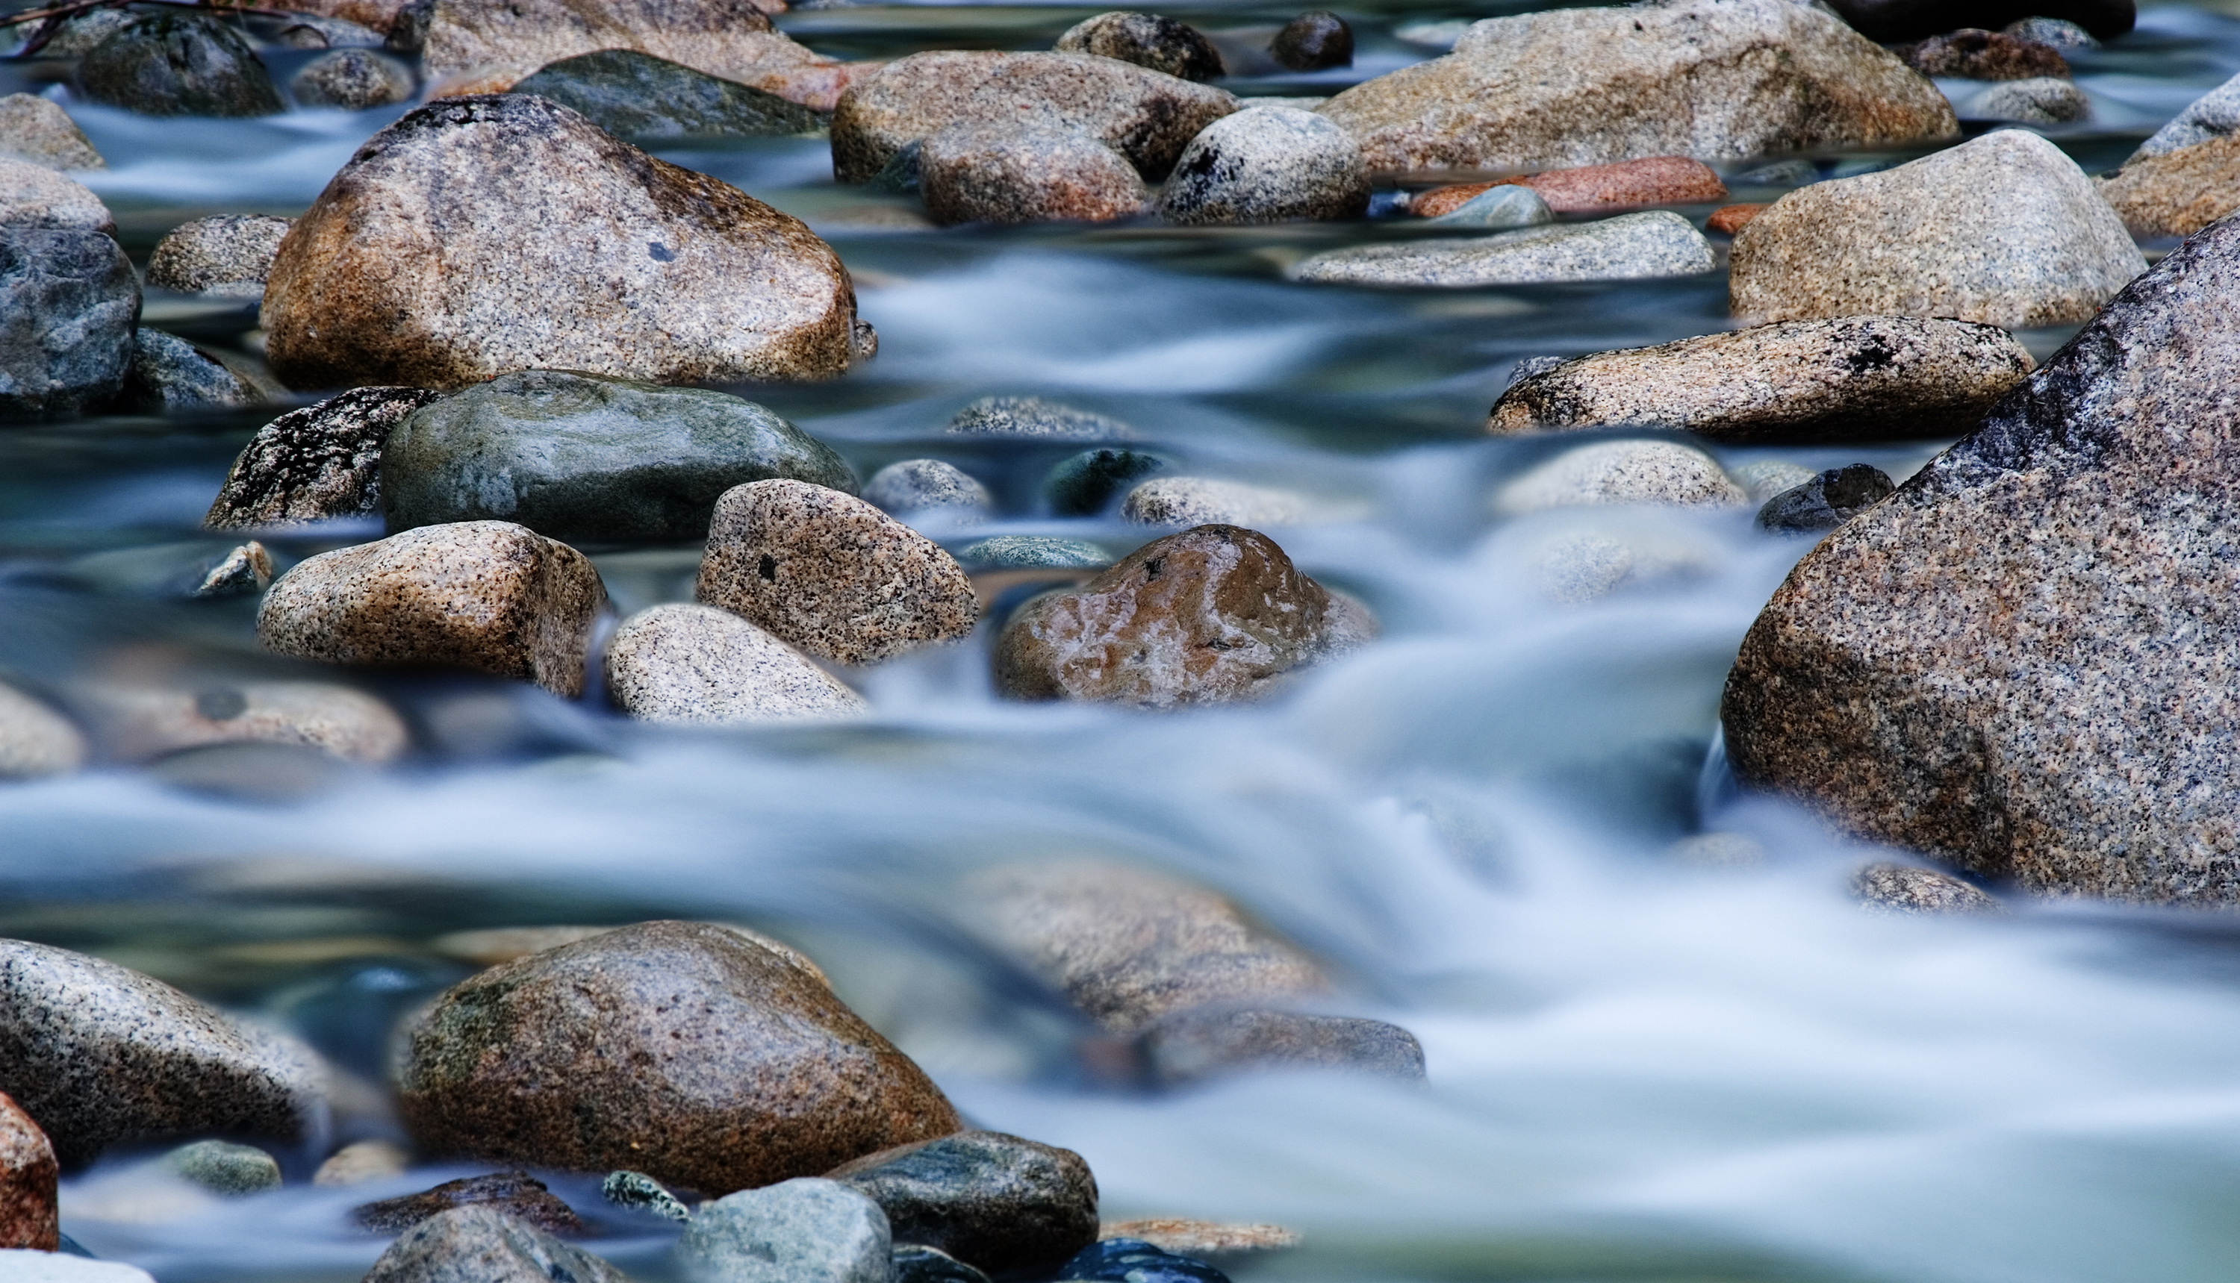
Risk assessment
Notes:
Health & safety:
Most of the survey work can and should be safely conducted from the riverside path, with the very occasional need to enter the river.
Please do not go into a river deeper than Wellington boot depth. Assess the river's conditions before doing so.
Be cautious on the riverbank of slips, trips and falls.
Please do not touch the outfalls.
Survey in a group with at least one other member carrying a mobile phone in case of an emergency.
Carry a walking pole (or similar) to part vegetation such as brambles.
Long trousers and sturdy footwear are recommended.
Avoid giant hogweed. It can burn skin on contact.
Cover up cuts and abrasions in case of contact with water.

Slide 11

Rain
We need 48 hours of no or only light rain in the catchment before conducting any survey work
Too much surface water will:
Mask background misconnections issues
Wash away grey (sewage) fungus and other evidence of pollution
Notes:
This slide is based on the national scheme developed by ZSL with Thames water which has a very different Network to what MRT has up here in the North West with UU, as such edits to the national method has been made. The ideal timeframe for the national scheme is between April and June, unless rain forces monitors to extend the survey period.
Sometimes rain is unavoidable therefore there is a rainfall question in the survey.

Slide 12
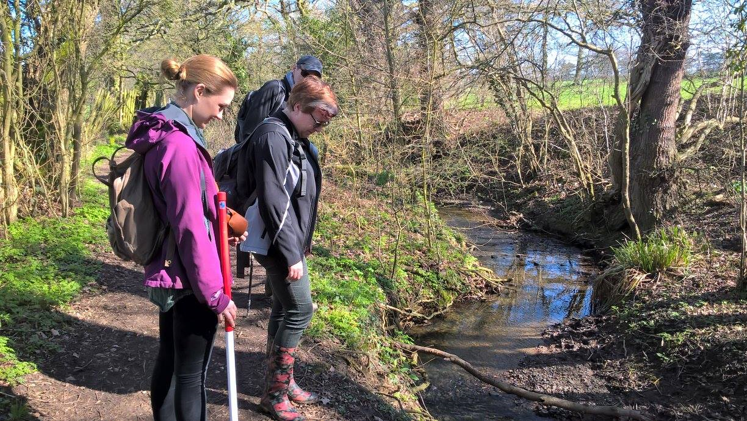
Kit list for Outfall Safari
Welly boots / sturdy footwear
Volunteer handout
Robust long trousers - brambles
Antibacterial hand gel
Phone (charged and loaded with project app)
A stick / pole – useful for brushing aside vegetation

Slide 13
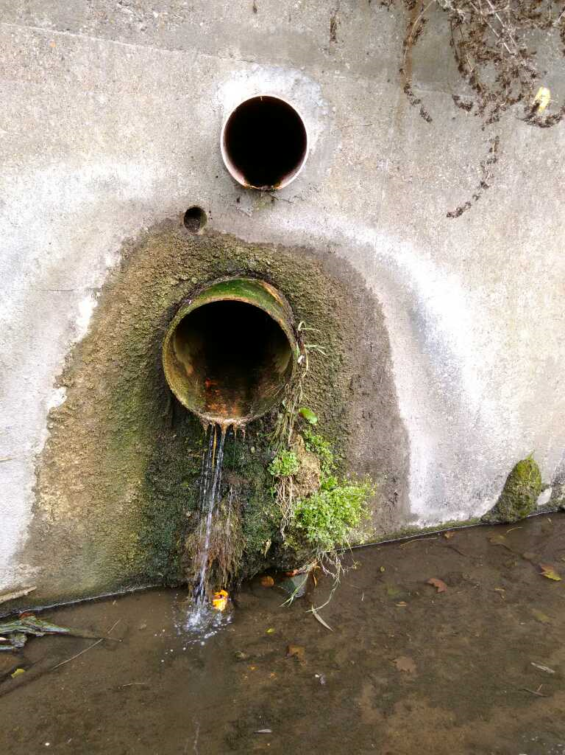

Outfall Safari app
Epicollect is the server Mersey Rivers Trust are using to collect this data. You can use Epicollect on a laptop or via an app
All you need is an email address which you have access to log in
Downloading the app. Epicollect is available on Apple Store/ Google Store - any problems, let us know?
Only one form per outfall, please

Slide 14
The Assessment Questions in the App
Please ensure that only one person completes an assessment form at each outfall, as it is vital to avoid receiving multiple forms for a single outfall.
1) Volunteer name: You must include your name so that if we have any queries whilst processing the data, we know who to contact
2) Date of survey
3) GPS location: Please stand as close as (safely) possible to the outfall when recording the GPS location. This may take a little while to locate, but be patient. Please try to get the location accurate
4) Describe the nearest landmark: Please let us know the nearest road/ building name or number, bridge, etc. It is helpful to be as descriptive as possible of the nearest landmark – what is the nearest road or identifiable building to the outfall, how many other outfalls can be seen from this location, is the surveyor standing on the same bank as the outfall, etc. If near a residential area, the nearest house number is also useful
5) Has it rained in the last 24 hours
6) Photo of the outfall: Clear photos of the outfall and associated impact help with processing and quality control of the date.
Notes:
Ideal for this photo to be a face on photo of the outfall/ so you can see the survey site.
This is a record what you see survey not what you know.

Slide 15
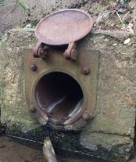
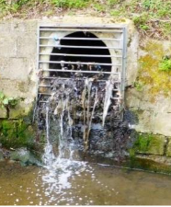
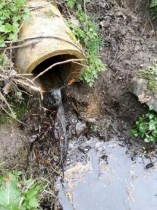
7) Which bank is the outfall on: This should be left or right as you stand looking downstream
8) What size is the outfall pipe? Which range does the pipe fit in 0-10cm, 10-30cm, 30-50cm, 50-100cm, >100cm
9) Ranking of the flow coming out of the outfall: The categories for this; trickle, low, moderate and high flow, are quite subjective
9. Ranking of the flow coming out of the outfall
No flow | 0
Trickle: < 0.1 l/s (or enough to fill a teacup in a minute) | 1
Low flow: Between 0.1 and 1 l/s (or enough to fill a bucket in a minute) | 2
Moderate flow: 1 to 2 l/s (more than a bucket-full each minute) | 3
High flow: Clearly > 2 l/s (more than a bathtub in a minute) | 4
Trickle
Low Flow
Moderate Flow

Slide 16
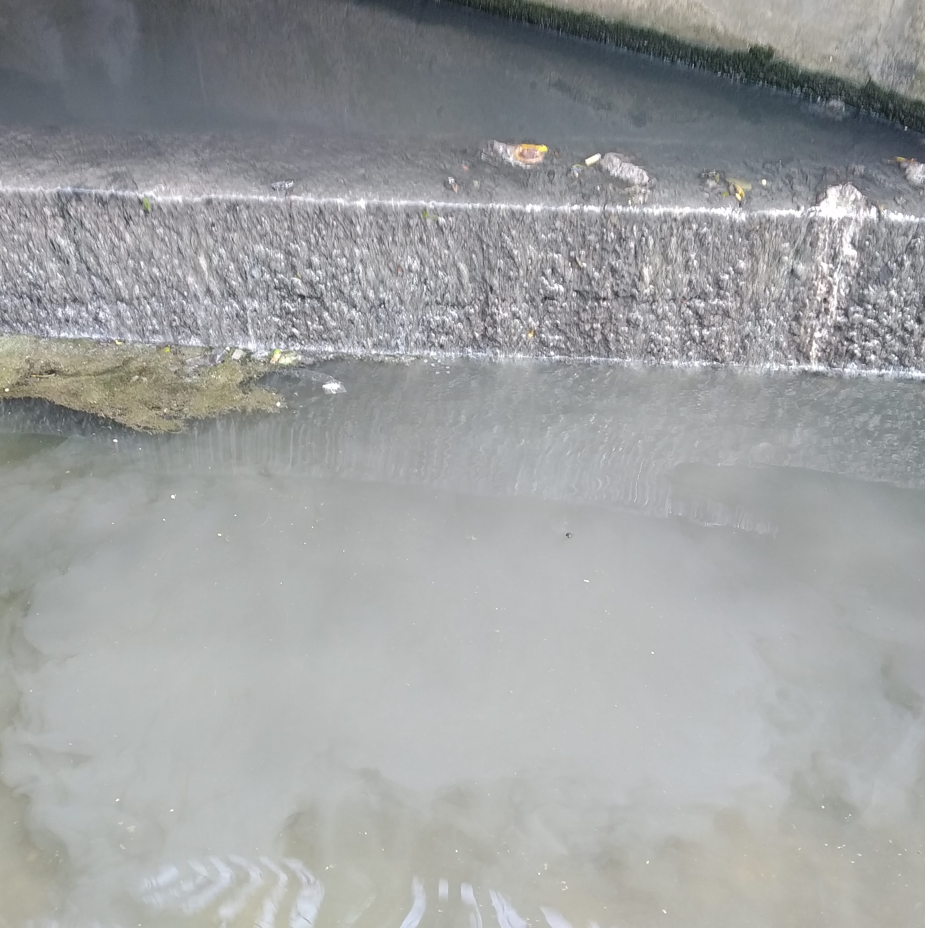
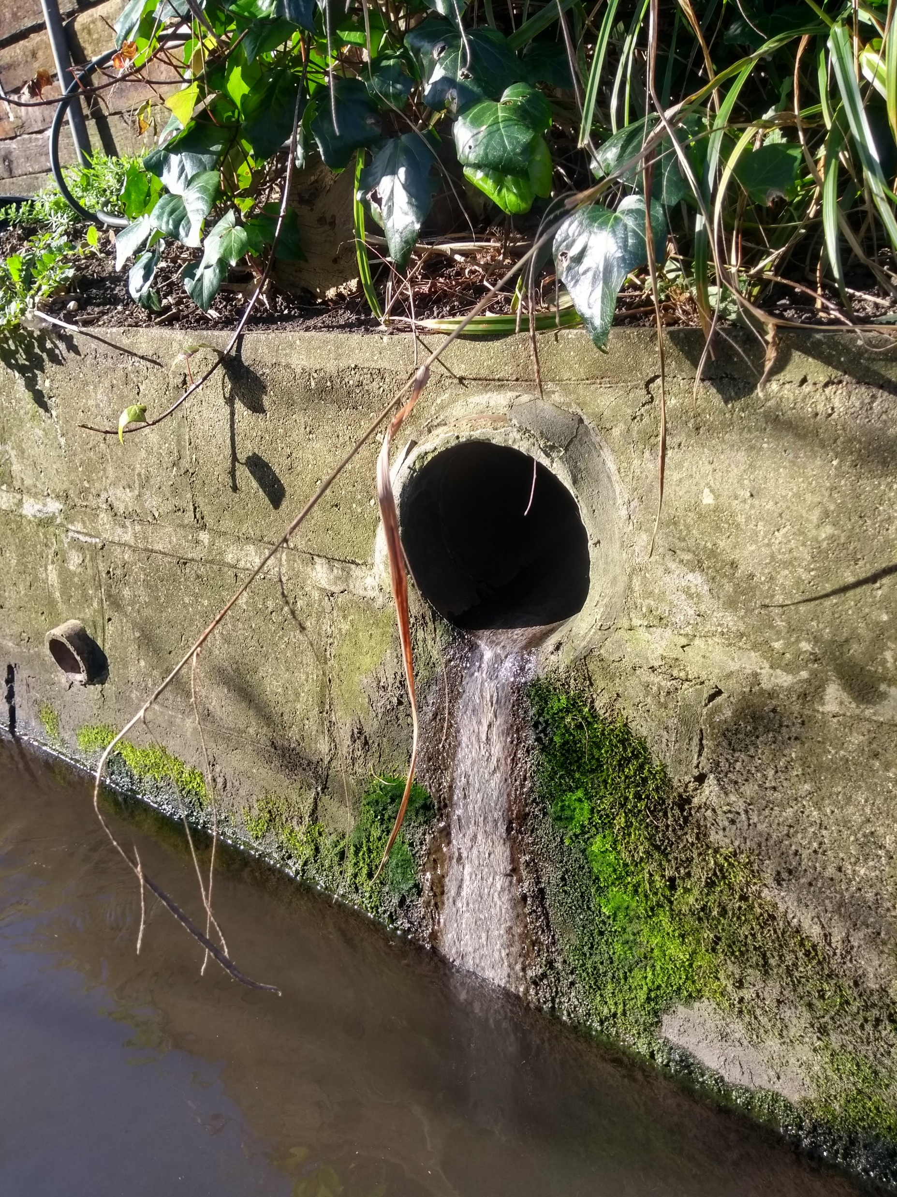
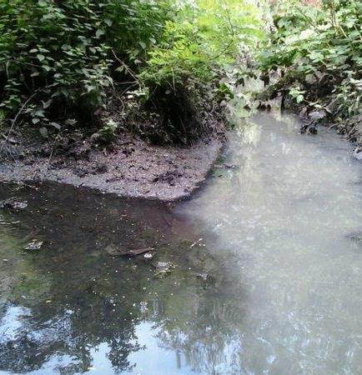
Examples of impact
10) Ranking of the visual impact of the outfall: How far from the outfall can you see signs of pollution?
Signs of pollution include:
Grey fungus (commonly known as sewage fungus): Seen as grey, often tufty growth on the riverbed.
Foam or scum on the surface of the river.
Plume of discoloured water.
Sewage-related debris, e.g. sanitary products (‘rag’).
10. Ranking of the visual impact of the outfall
No visible effect | 0
Within 2m of the outfall | 2
Impact 2 to 10m | 4
Impact 10-30m | 6
Impact greater than 30m | 10

Slide 17
11) Ranking of the aesthetics of the outfall: Please tick the category that most closely matches what you see at the outfall you are assessing (there might not be a perfect fit)
11. Ranking of the aesthetics of the outfall
No odour or visible aesthetics | 0
Faint smell, slight discolouration | 2
Mild smell, mild discolouration, small coverage of sewage fungus | 4
Strong smell, strong discolouration, large coverage of sewage fungus and/or litter | 6
Gross smell, gross sewage | 10

Slide 18
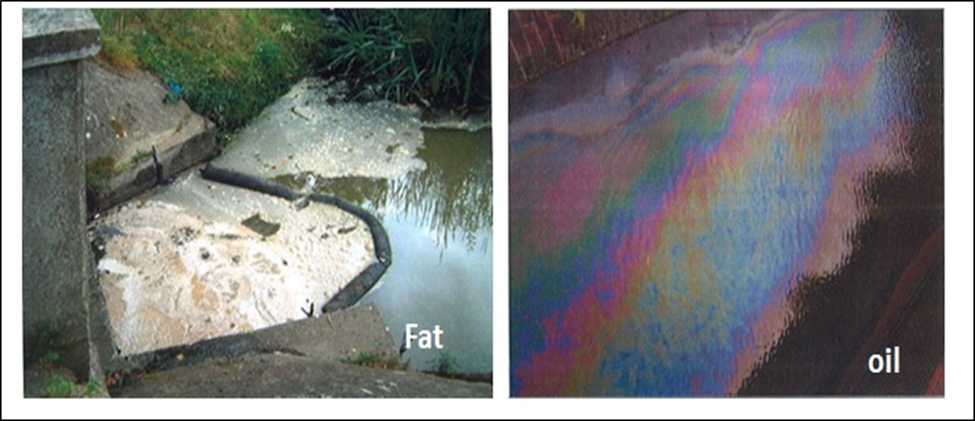
12) Is any sewage-related debris visible?
13) Other signs of pollution: Free text can be used to describe pollution that is not covered by earlier questions. If you can see other forms of pollution from an outfall please provide details
14) Please upload photos of the outfall,
the visual impact photo, and any sewage
fungus photo, etc.
• What colour is the water?
• Is oil or fat present? If yes, what colour?
• Is food waste present?
• Are silt/construction materials present, etc.
© Environment Agency

Slide 19
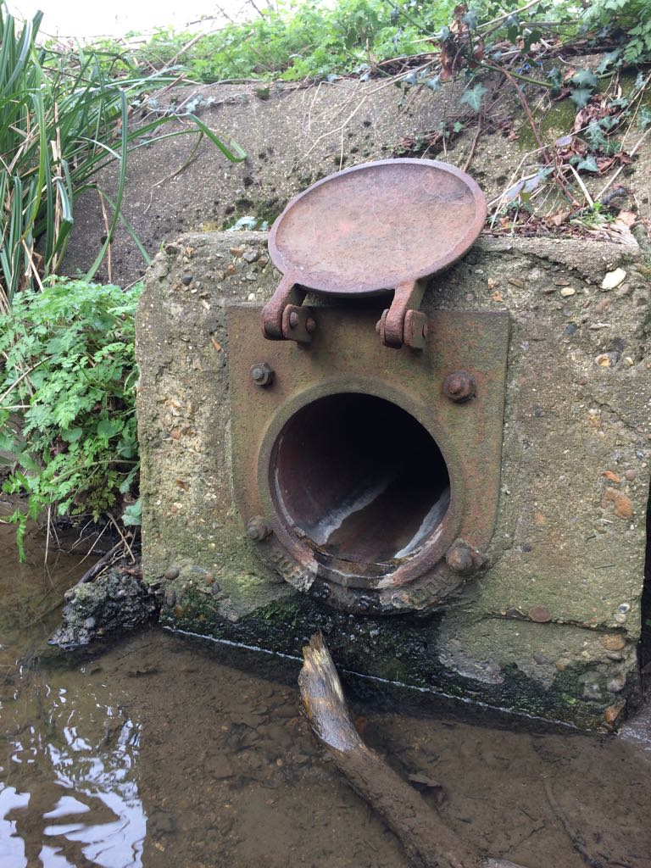
Uploading the data you have collected
Once you have answered the questions make sure you save the form you have filled in before moving onto the next
Uploading the data:
You don’t need an internet connection to fill in the forms and collect data. You can store each form on the app and then upload them all onto the database when you next connect to the internet

Slide 20

Reporting from the river
Please report any pollution that has an impact of greater than 10 meters and is worse than ‘Mild smell, mild discolouration, small coverage of sewage fungus’ straight away to the Environment Agency on the number below.
Send any pollution report reference numbers to the survey co-ordinator for inclusion in the final survey report
For major pollution incidents, contact the Environment Agency
0800 807 060
Notes:
Report an incident online:
Report an environmental problem - GOV.UK
More information about reporting incident can be found here:
'Report an environmental problem' at your fingertips | Engage Environment Agency
Report an environmental problem - GOV.UK

Slide 21
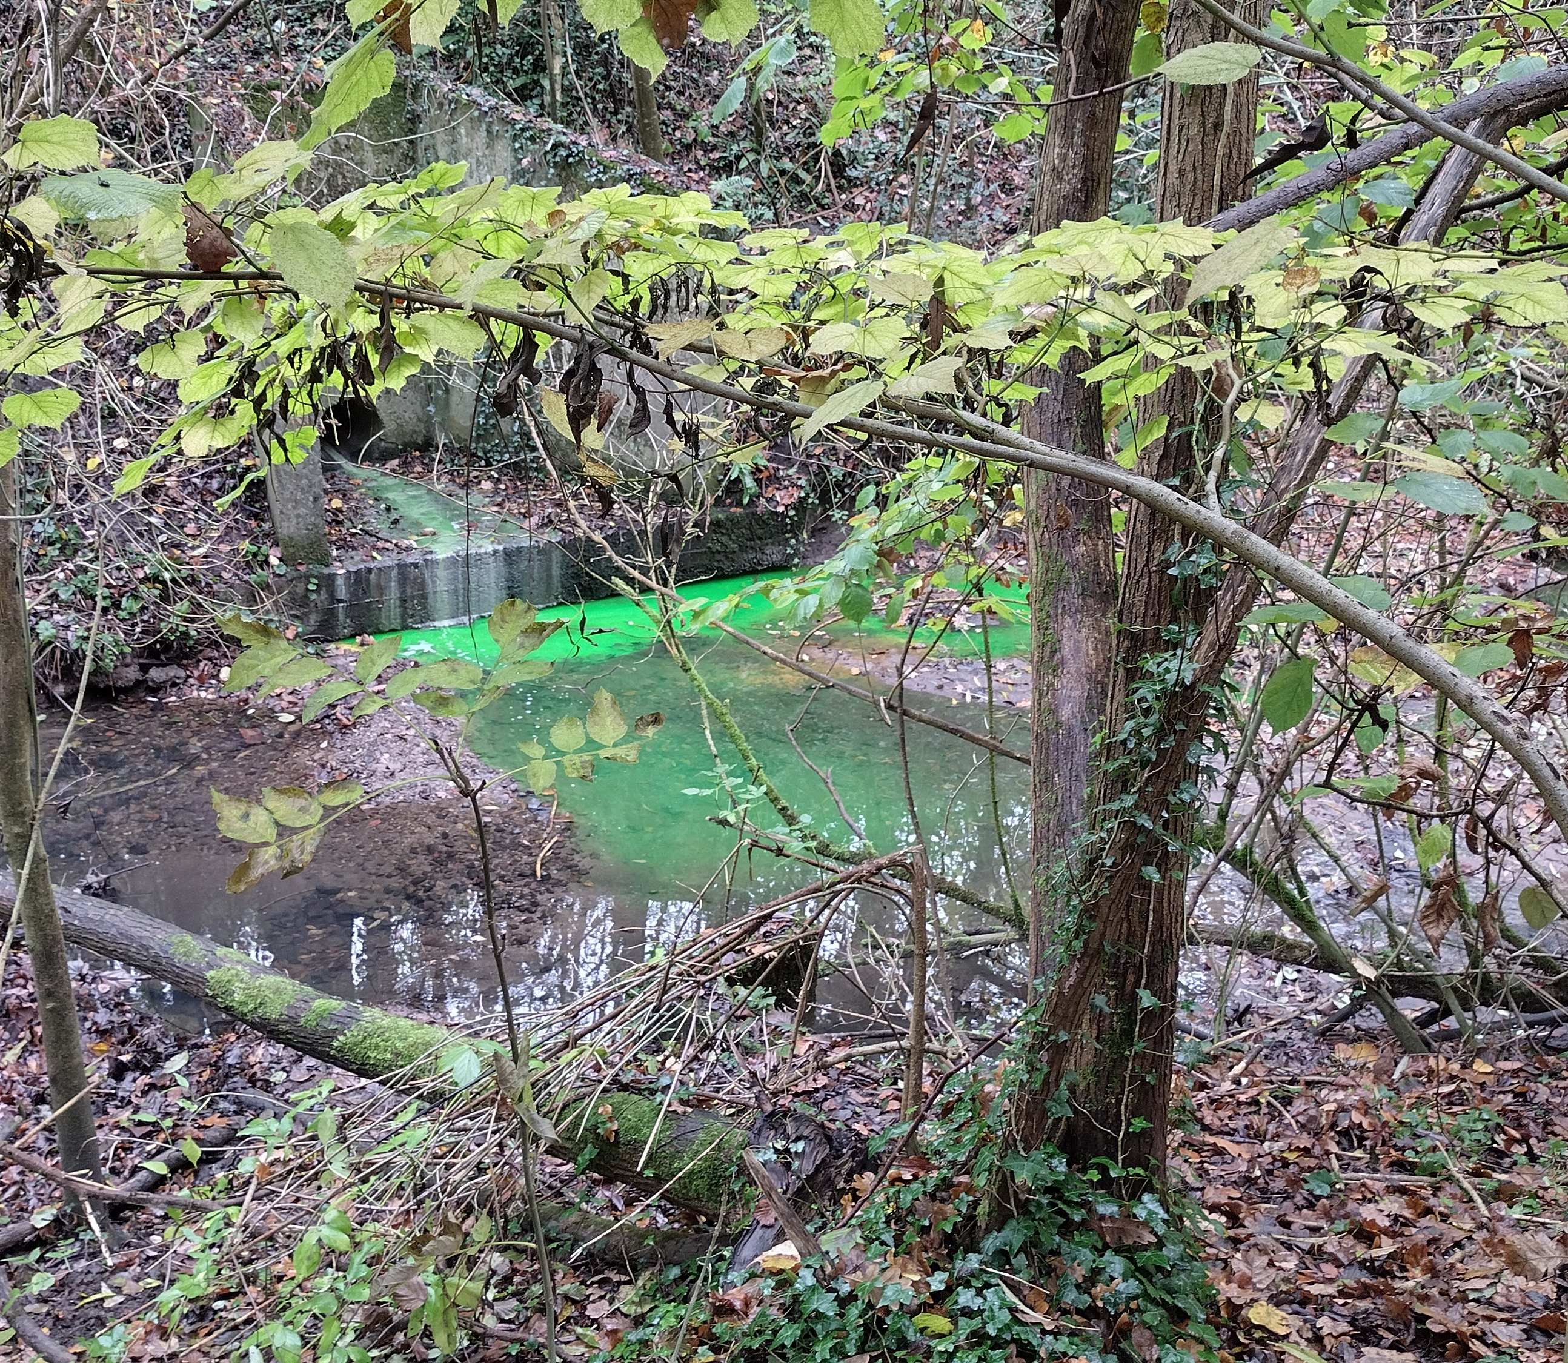
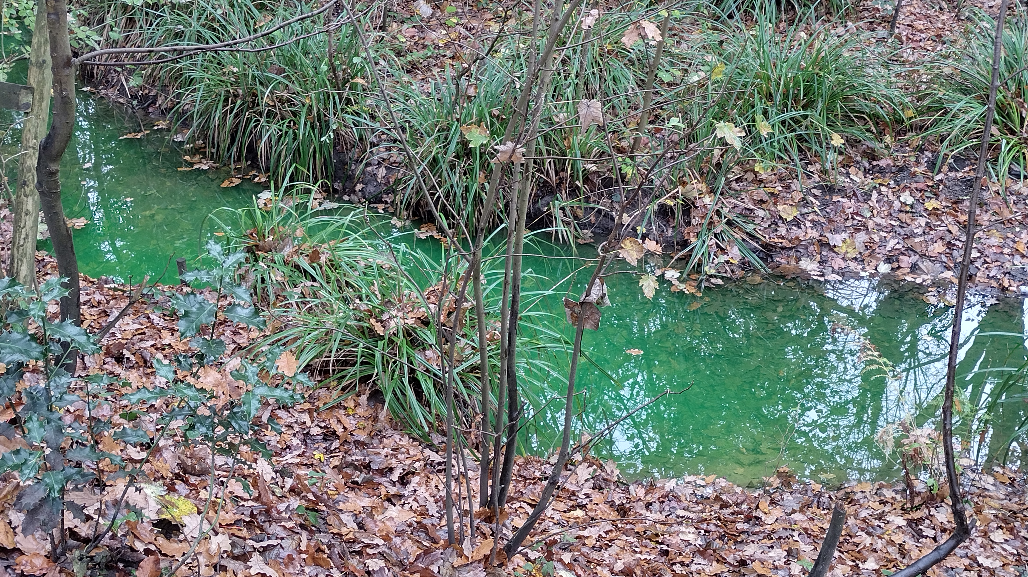
9. Ranking of the flow coming out of the outfall
No flow | 0
Trickle: < 0.1 l/s (or enough to fill a teacup in a minute) | 1
Low flow: Between 0.1 and 1 l/s (or enough to fill a bucket in a minute) | 2
Moderate flow: 1 to 2 l/s (more than a bucket-full each minute) | 3
High flow: Clearly > 2 l/s (more than a bathtub in a minute) | 4
10. Ranking of the visual impact of the outfall
No visible effect | 0
Within 2m of the outfall | 2
Impact 2 to 10m | 4
Impact 10-30m | 6
Impact greater than 30m | 10
11. Ranking of the aesthetics of the outfall
No odour or visible aesthetics | 0
Faint smell, slight discolouration | 2
Mild smell, mild discolouration, small coverage of sewage fungus | 4
Strong smell, strong discolouration, large coverage of sewage fungus and/or litter | 6
Gross smell, gross sewage | 10
Original score = 12
Amended score = 18
found out the impact went more than 30m downstream.
Notes:
Staff to fill in

Slide 22
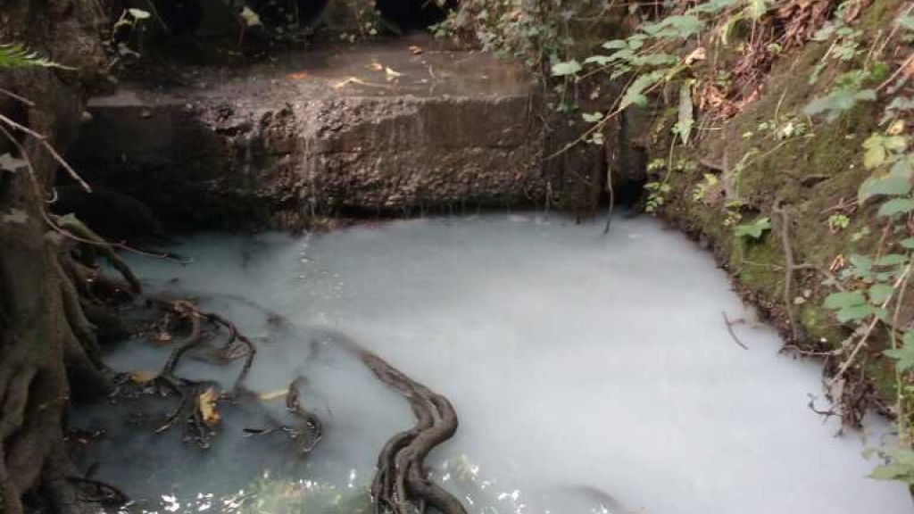
What will happen with the data?
Converted to impact scores for each outfall
Reported to the Catchment partnership, Environment Agency and United Utilities
Serious issues should be dealt with immediately - other issues indicative of misconnections should be included in catchment plans to be addressed in the future.
Notes:
We are collecting this data to trail how to feed this data into UU and EA networks.

